Slide 1
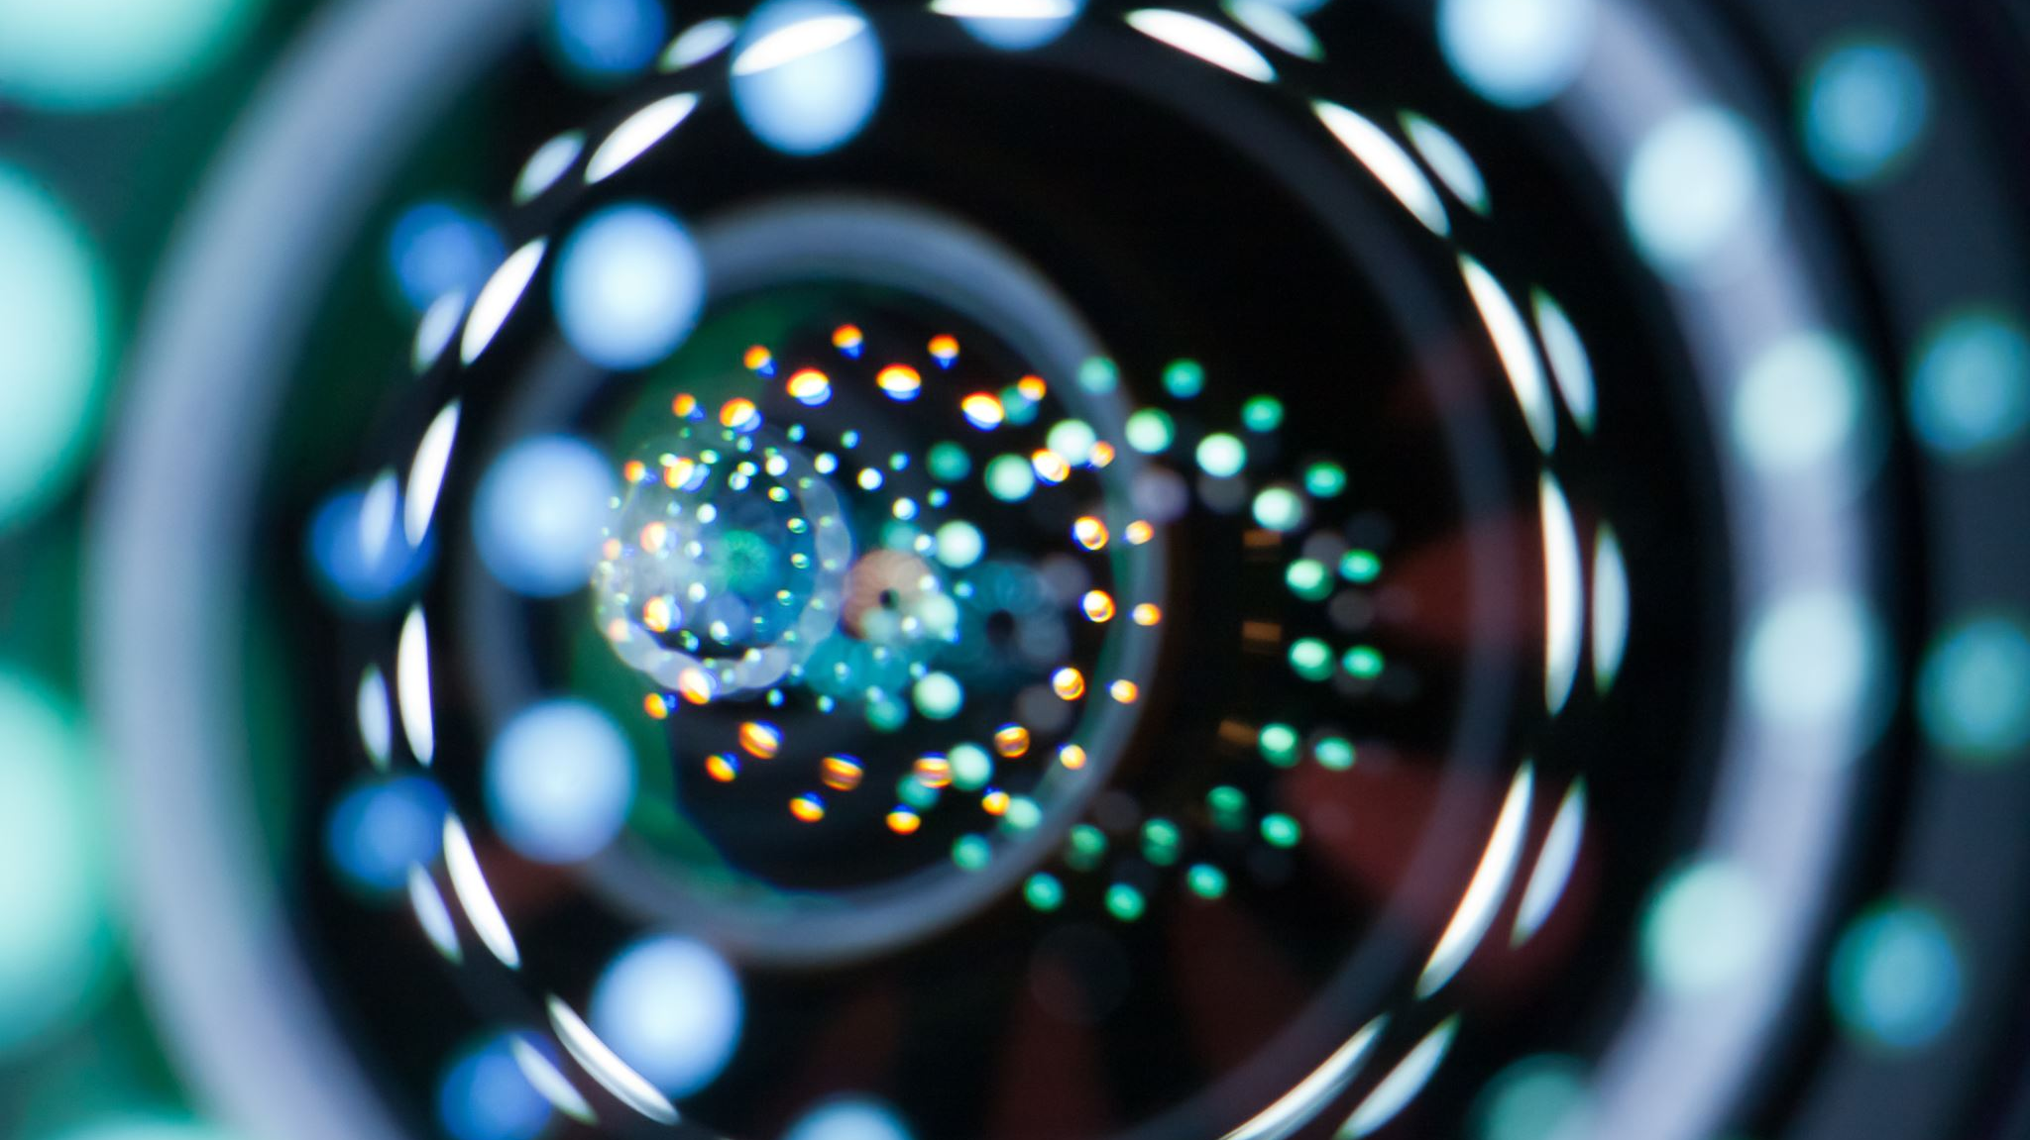
Visão Computacional
Limelight

Slide 2
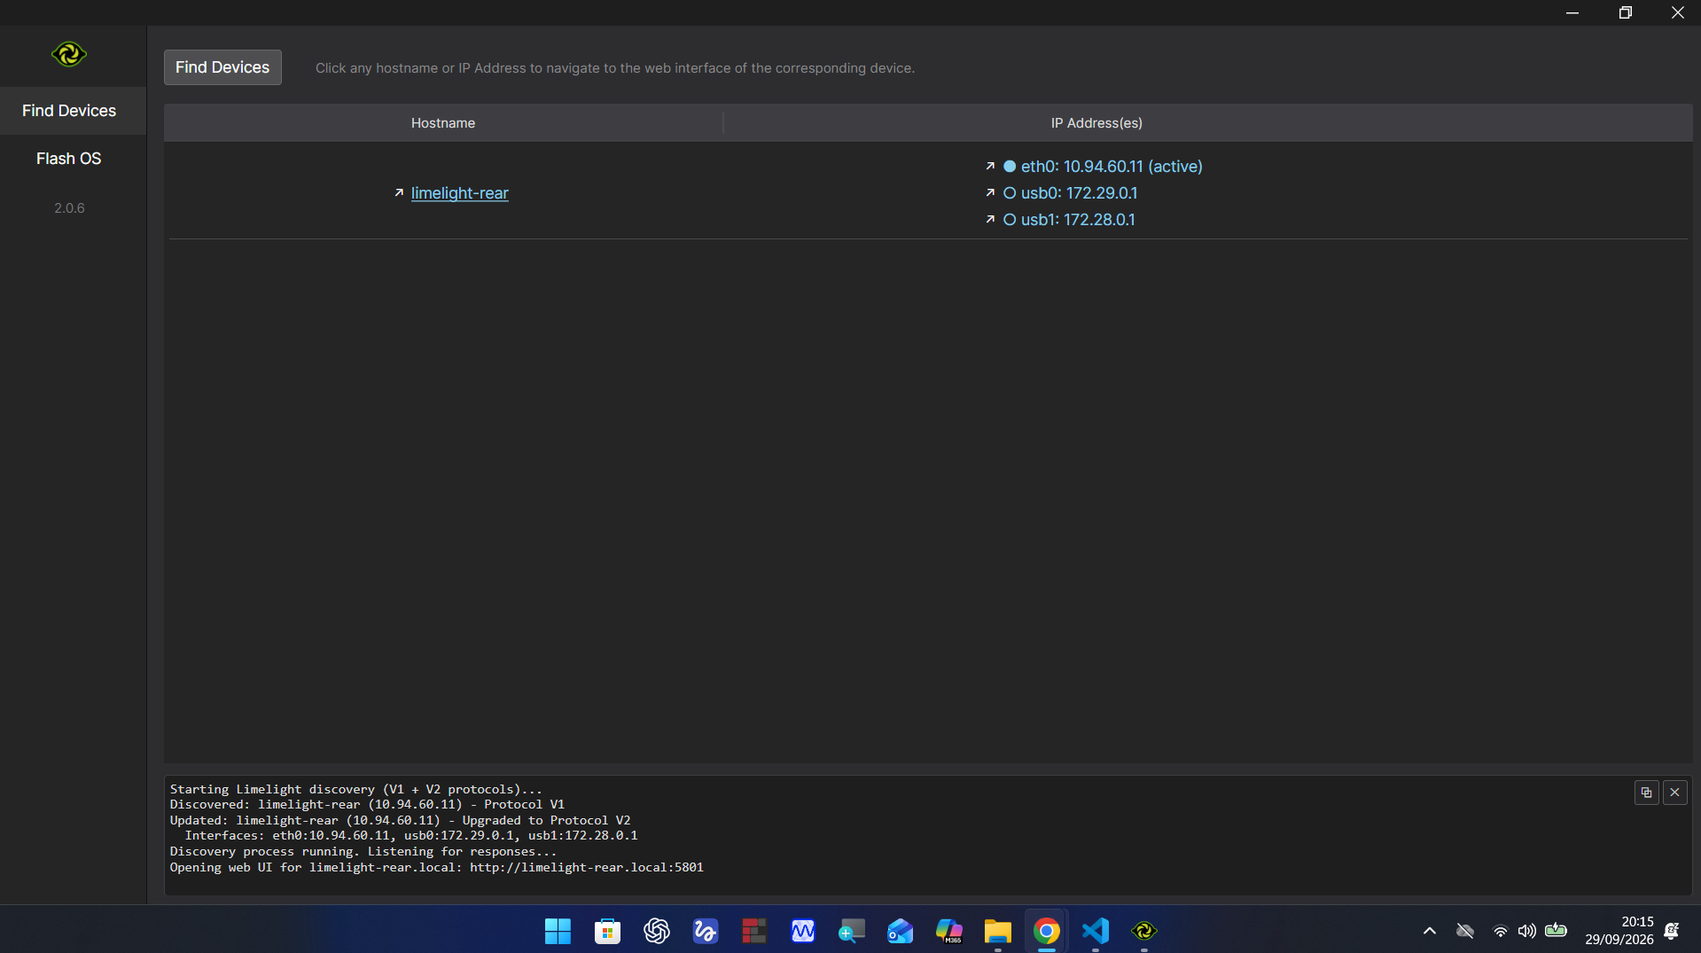
Instale o software da lime light conseguimos fazer a calibração dela por ele

Slide 3
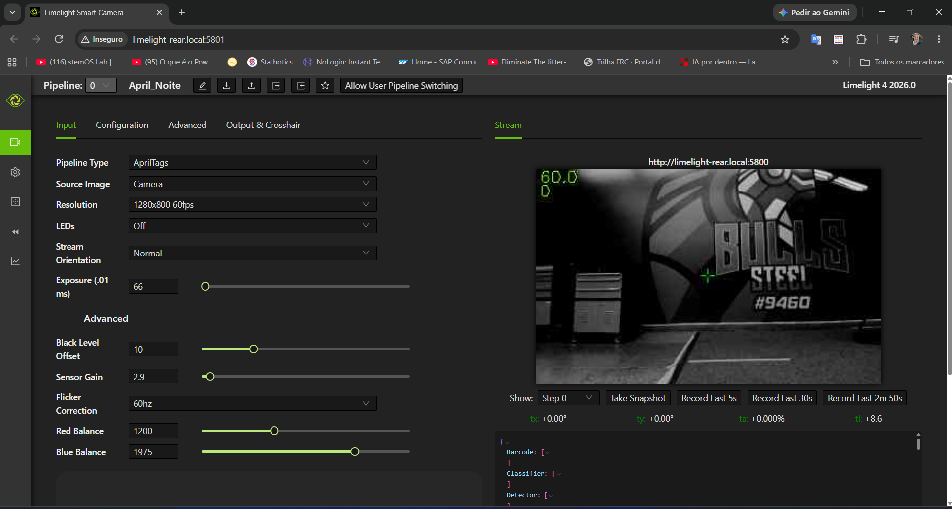

Slide 4
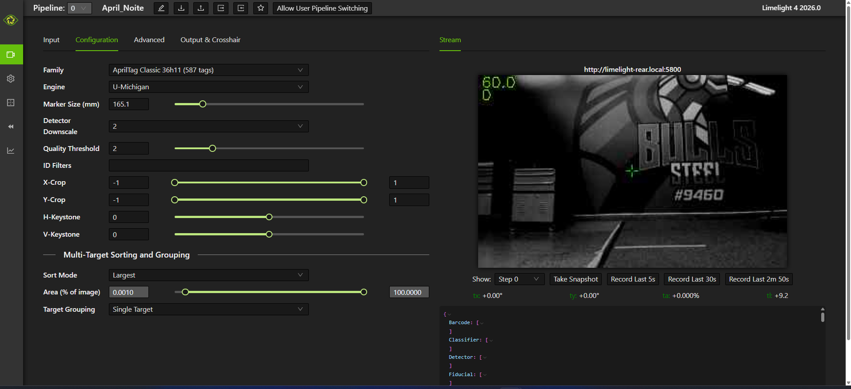

Slide 5
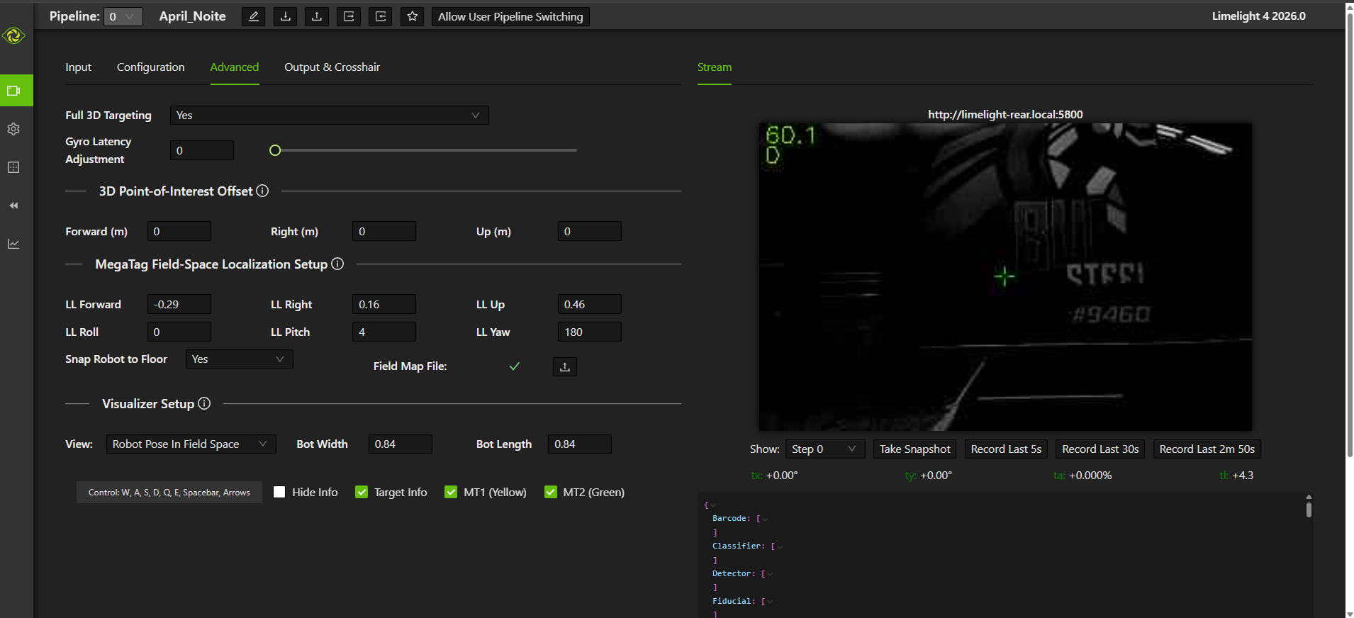

Slide 6
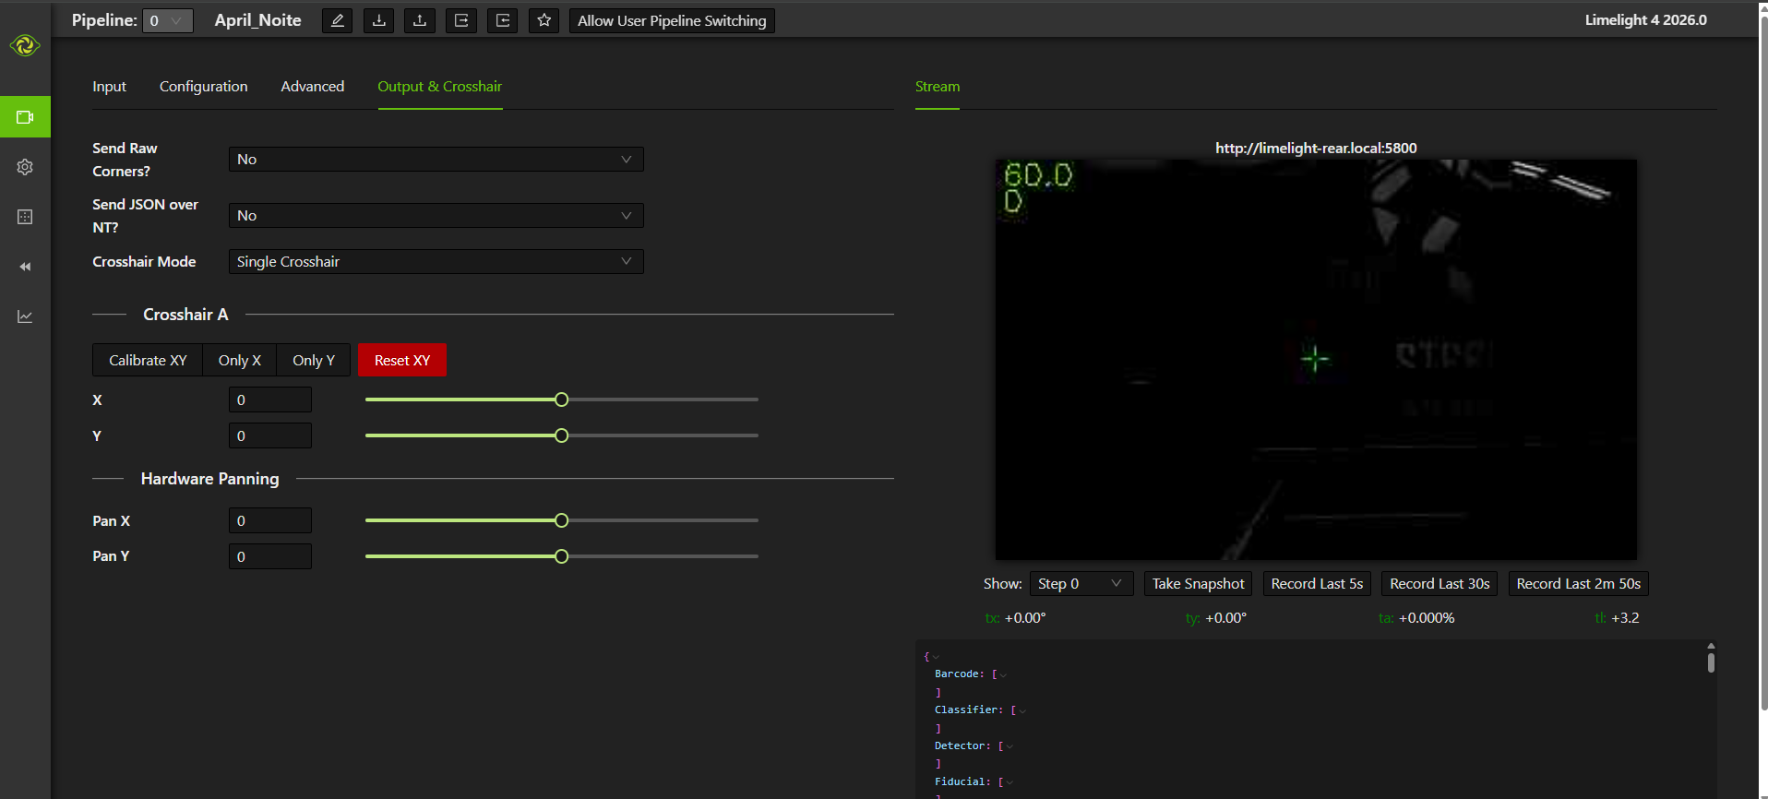

Slide 7
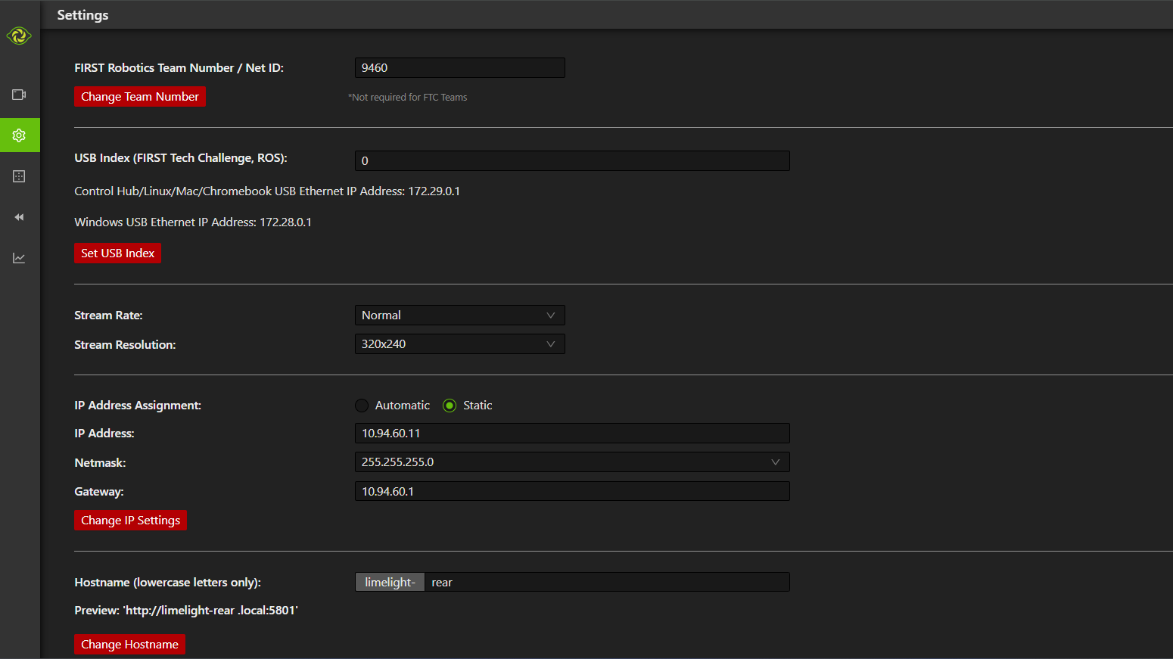

Slide 8
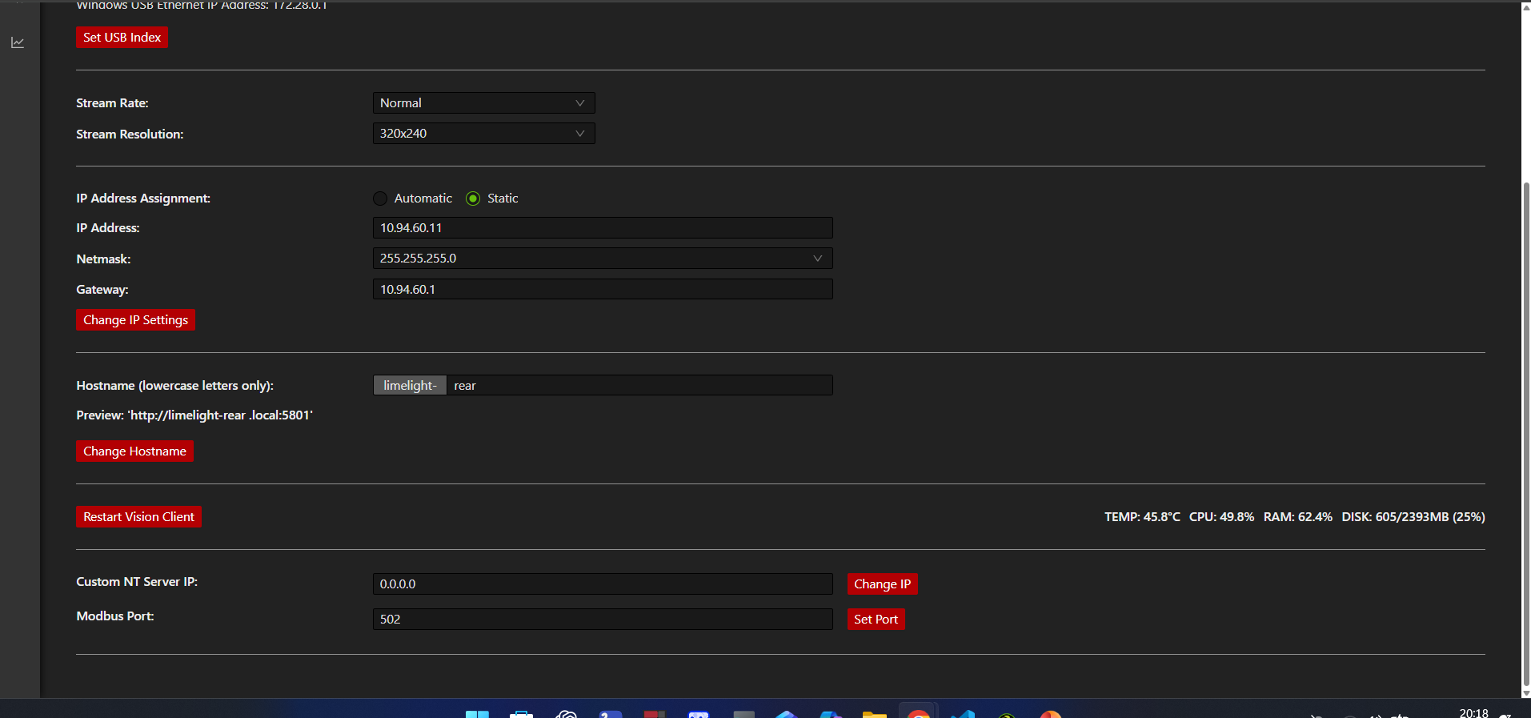

Slide 9

Abra o Git
https://github.com/LimelightVision/limelightlib-wpijava/blob/main/LimelightHelpers.java?utm_source=chatgpt.com

Slide 10
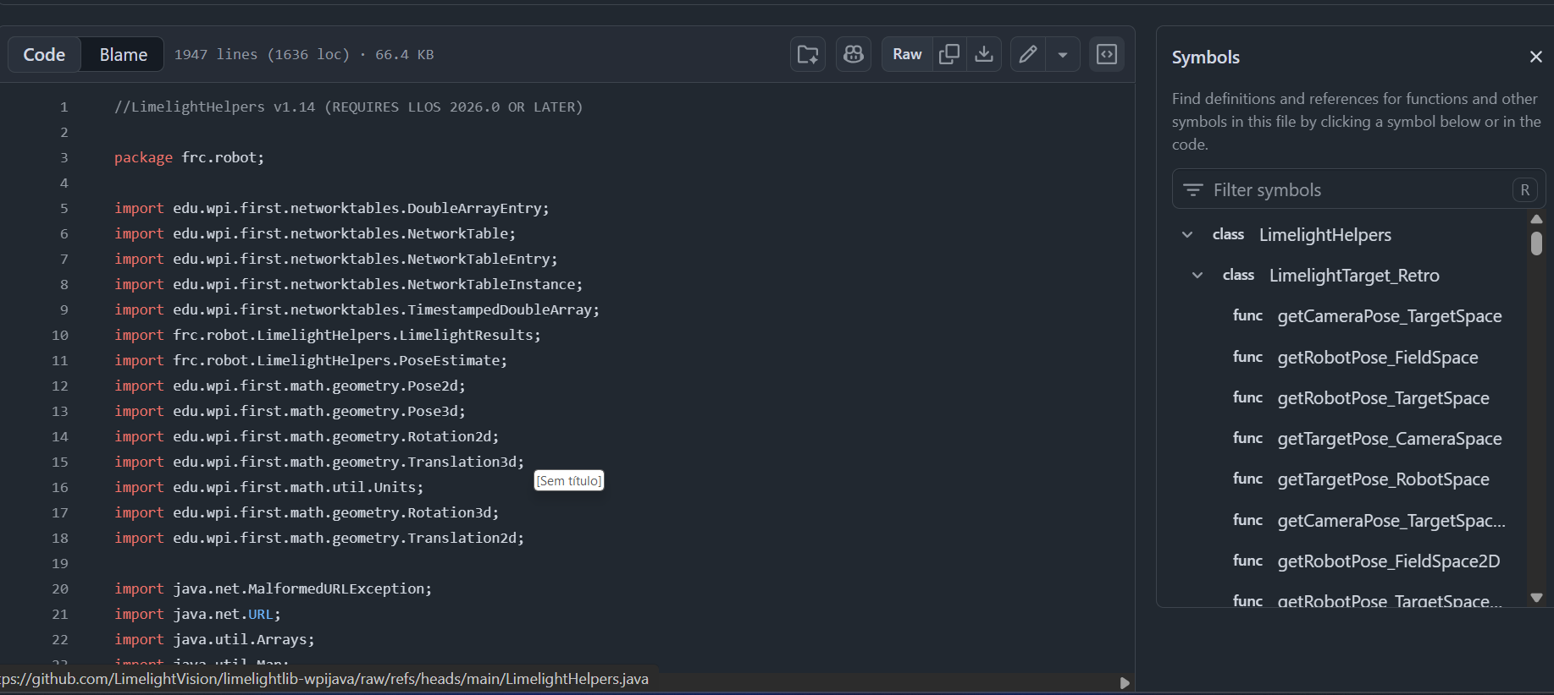

Slide 11
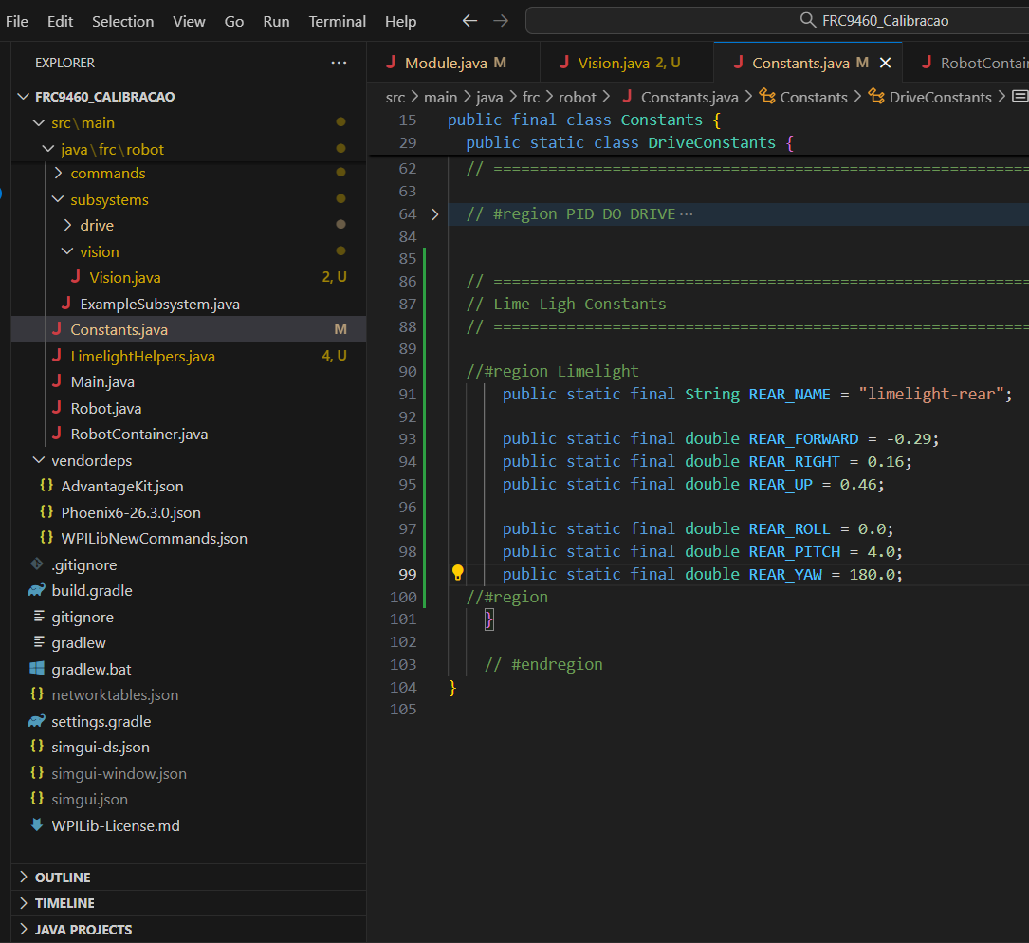
//#region Limelight
public static class LimelightConstants {
// ============================================================
// Lime Ligh Constants
// ============================================================
public static final String REAR_NAME = "limelight-rear";
public static final int[] VALID_TAG_IDS = {25, 26};
public static final int IMU_MODE = 0;
public static final double REAR_FORWARD = -0.29;
public static final double REAR_RIGHT = 0.16;
public static final double REAR_UP = 0.46;
public static final double REAR_ROLL = 0.0;
public static final double REAR_PITCH = 4.0;
public static final double REAR_YAW = 180.0;
}
//#region
Posição da Limelight
Em relação ao robô

Slide 12
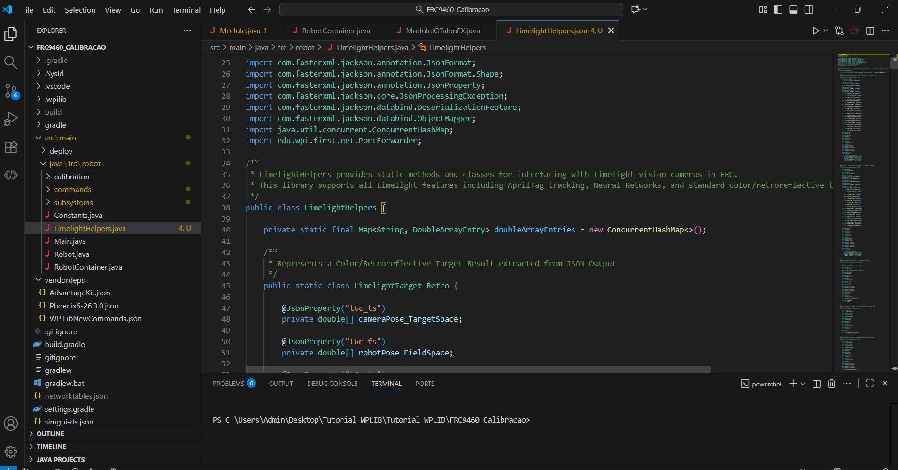

Slide 13
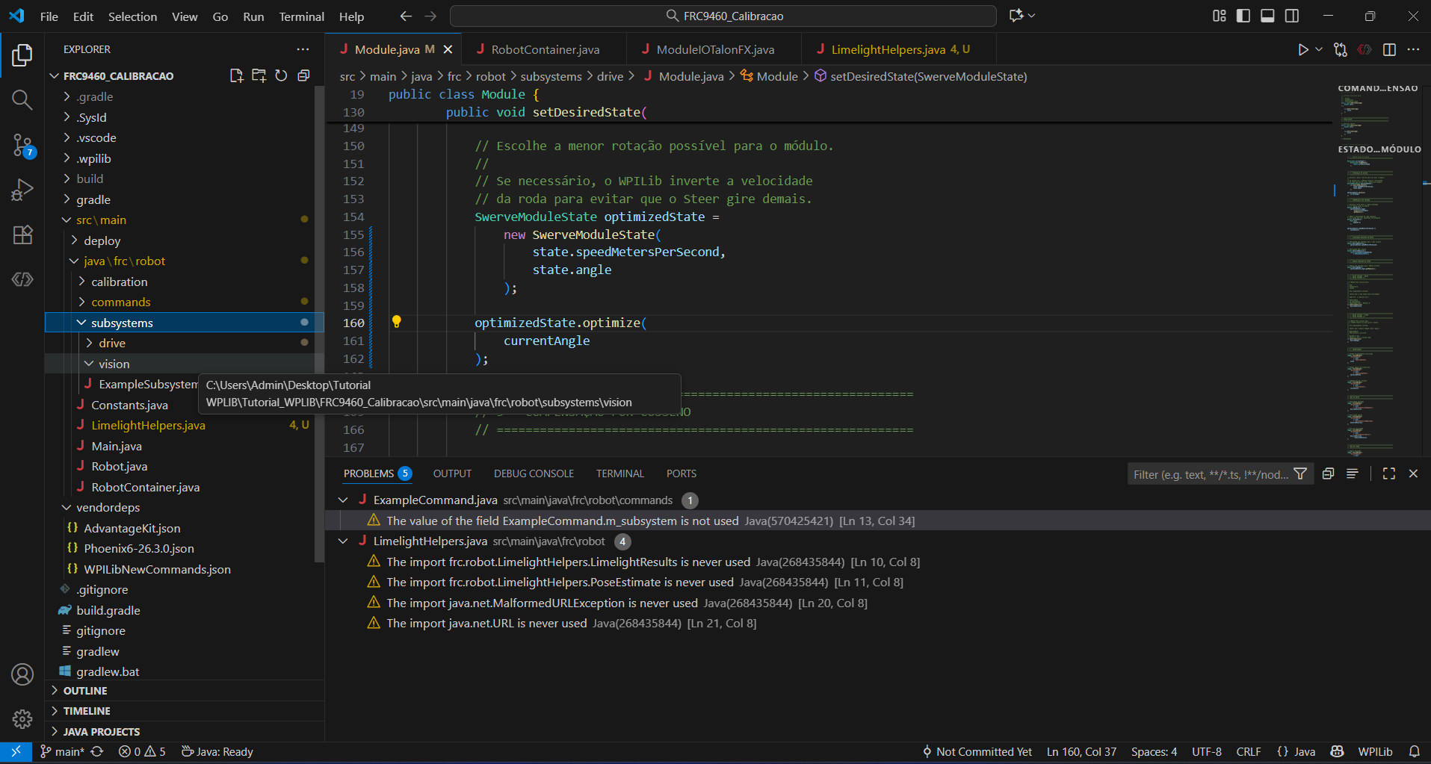
Crie uma pasta vision

Slide 14
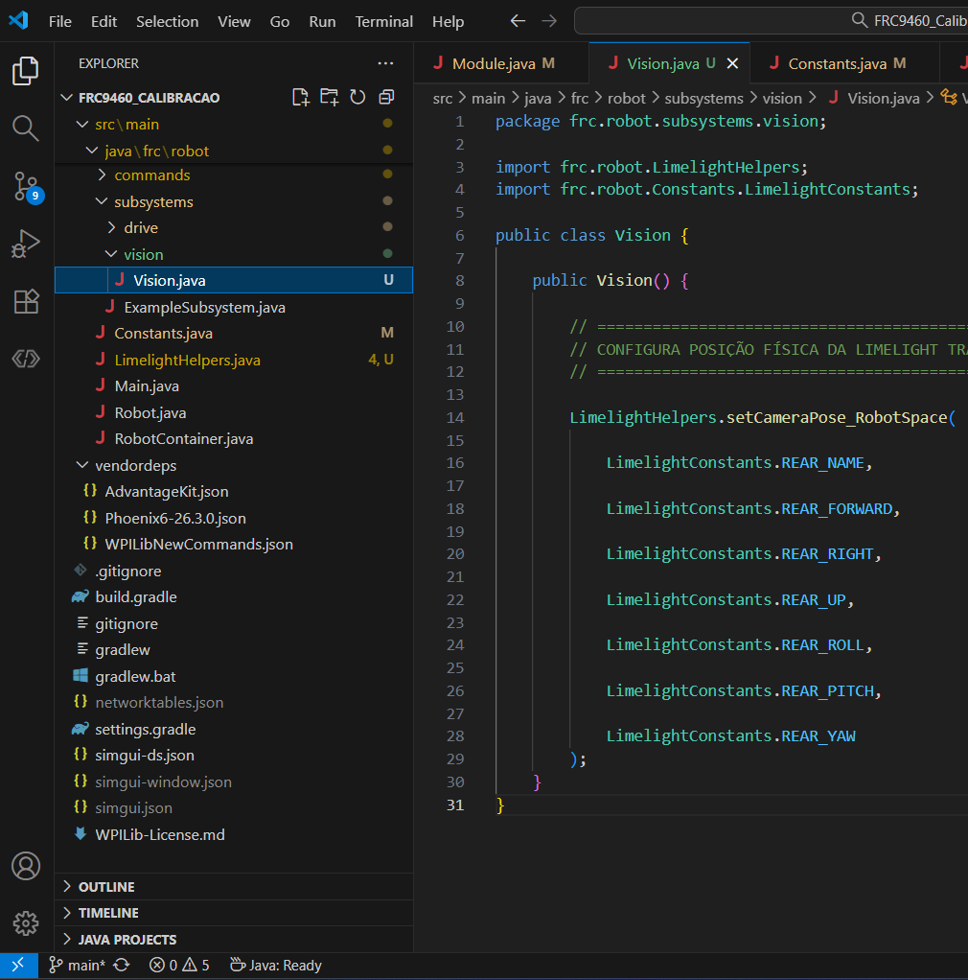
package frc.robot.subsystems.vision;
import frc.robot.LimelightHelpers;
import frc.robot.Constants.LimelightConstants;
public class Vision {
public Vision() {
// ============================================================
// CONFIGURA POSIÇÃO FÍSICA DA LIMELIGHT TRASEIRA
// ============================================================
LimelightHelpers.setCameraPose_RobotSpace(
LimelightConstants.REAR_NAME,
LimelightConstants.REAR_FORWARD,
LimelightConstants.REAR_RIGHT,
LimelightConstants.REAR_UP,
LimelightConstants.REAR_ROLL,
LimelightConstants.REAR_PITCH,
LimelightConstants.REAR_YAW
);
}
}

Slide 15
